Slide 1

Microservices
Code Mash Edition
Lessons from the Trenches
@gbworld

Slide 2
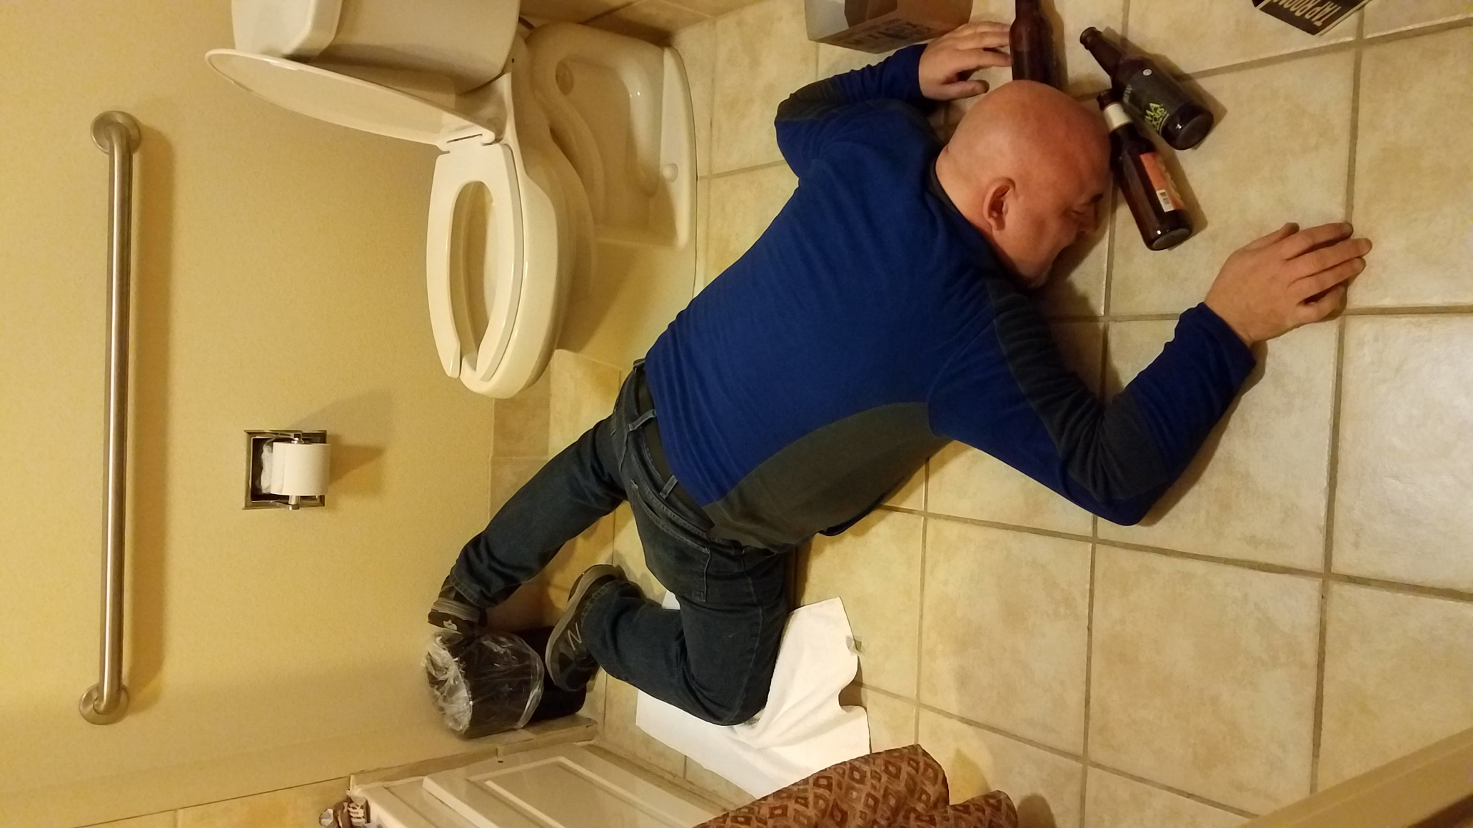
See Boss, The Money Spent Was Well Spent!
Notes:
For the record, this was added to the deck as a joke to break the ice.

Slide 3

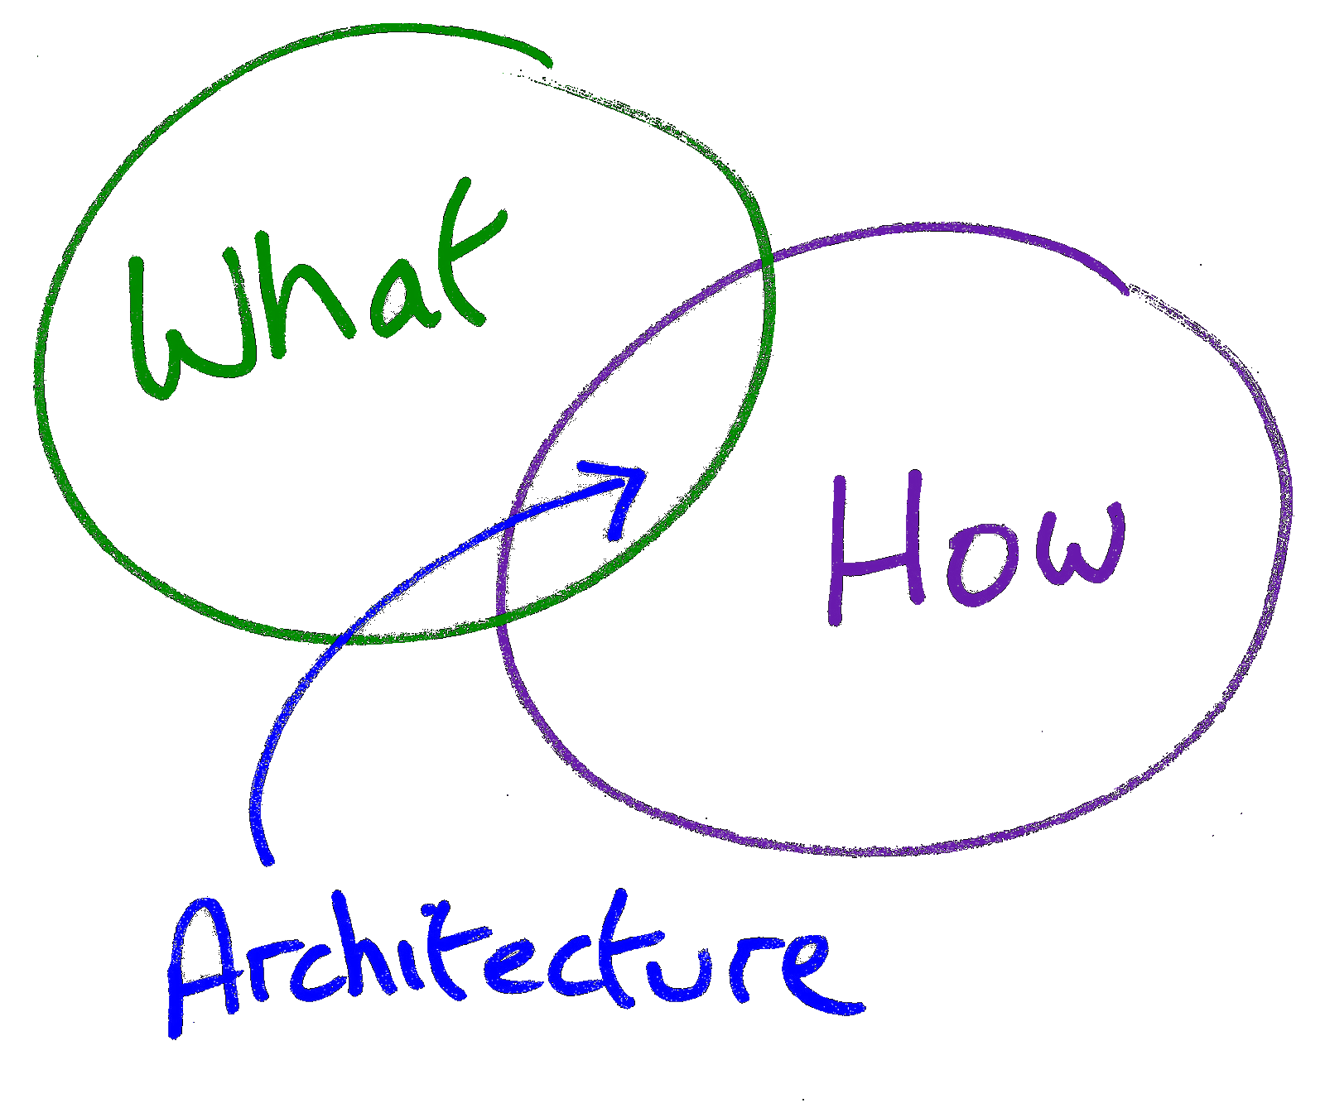





Who?
Senior Architect, UST Global
Microservices Practice
Senior Architect
Modernization
Integration
Service Enablement
Microservices
Other
Agile
DevOps
Gregory A. Beamer
Notes:
Pretty self explanatory

Slide 4
Opening Remarks
Insert Greg’s Random B*llsh*t Here Possibilities
Video Course
Architectural Styles
Other B*llsh*t
Notes:
I am in the beginning stages of a video course. Not sure if I will hit Pluralsight or aim for a platform like Udemy. Also going to have some free stuff on YouTube. ETA – within the next 3 months
As for architectural styles, I mentioned that Hexagonal Architecture (aka Onion Architecture, aka Clean Architecture (is the guy that named it that a purist?)) can be set up with the same code structure as tiered (aka layered) architecture. See slides 49-50.

Slide 5
1. In a Properly Architected Solution, What is the difference between a monolith and a microservice
POP QUIZ TODAY!
Boundaries and deployment methodologies
Notes:
These are mostly for further ice breaking (Yes, I throw candy) – To understand properly architected, examine slides 49 and 50 again

Slide 6
2. Why would you desire outer complexity over inner?
POP QUIZ TODAY!
Easier to Commoditize
Notes:
Commoditize means you can have someone else do the work. Think of buy versus build.

Slide 7
3. Using buzzwords only, name some practices, methodologies, etc. that complement microservices:
POP QUIZ TODAY!
Agile, DevOps, SOLID principles, monitoring, API management
Notes:
This does not mean you are 100% Agile, using DevOps in a pure manner. I won’t comment it does not mean SOLID, monitoring and/or API Management, however, as I find those are pretty critical to every solution, if you want to be able to maintain it

Slide 8
4. What benefit of microservices has no corresponding negative?
POP QUIZ TODAY!
Trick Question – There are NONE!!!
Notes:
There is nothing in the world that is 100% positive or 100% negative. Even Mother Theresa had some bad days and Hitler had some good. In fact, just as a thought experiment: I bet if you rated every second from the most evil and the most good people in history as neutral, bad or good, you would find most of us walk through life in neutral. What distinguishes the heavy achievers from those who chronically fail is keeping their brain and body in drive more often and only reversing when they realize they took the wrong course.

Slide 9
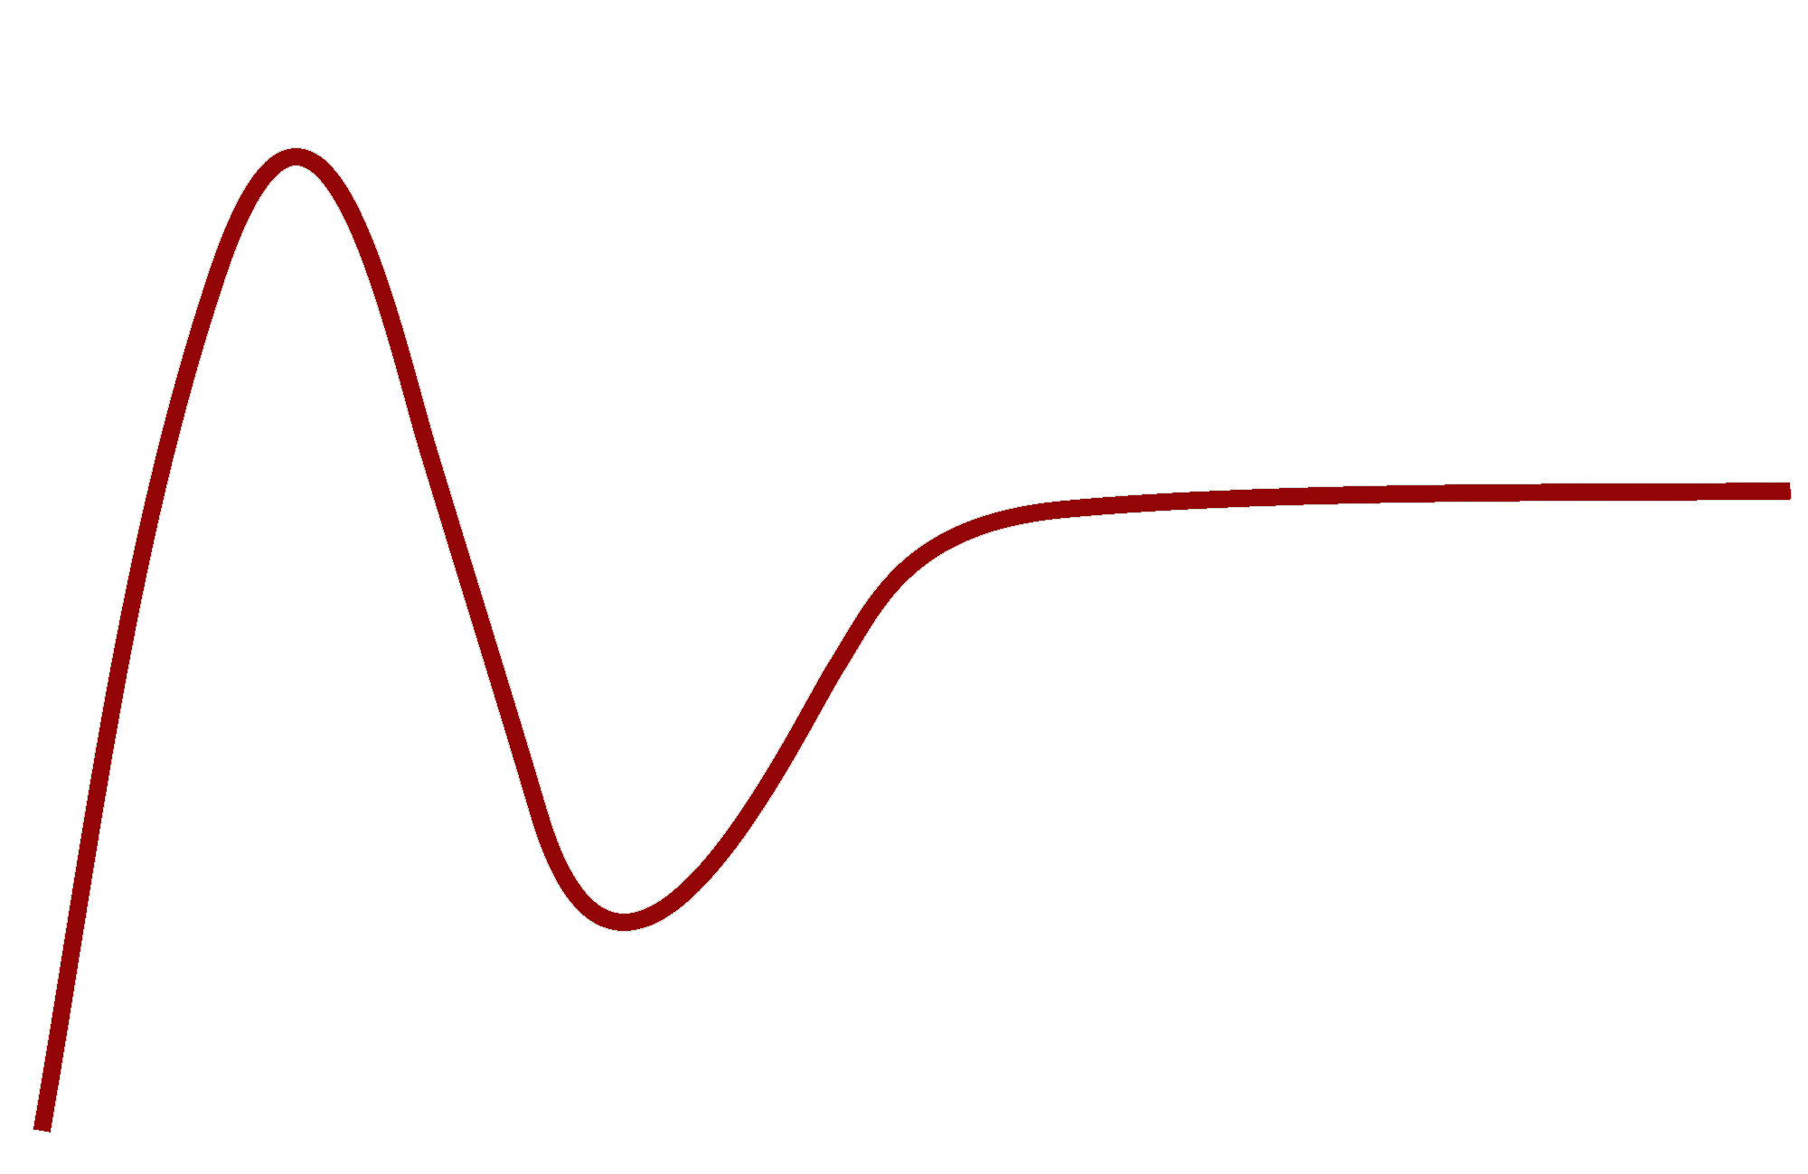

What?
Peak of Inflated Expectations
You Are Here
Silver Bullet
or Hot Air?
Plateau of Productivity
Visibility
Slope of Enlightenment
Trough of Disillusionment
Technology Trigger
Time
Notes:
This is the standard Gartner Hype Curve on new technologies. Microservices are at the top of the roller coaster and we are about to take the long ride to the bottom.

Slide 10
What?
Peak of Inflated Bull****!!!
You Are Here
Silver Bullet
or Hot Air?
Plateau of Resume Bullet Points
Visibility
Slope of “Oh, not all tools are hammer”
Trough of “Silver Bullets only Kill Werewolves”
Knee Jerk
Time
Notes:
This is a more human, and less stuffy, way to look at the curve.

Slide 11
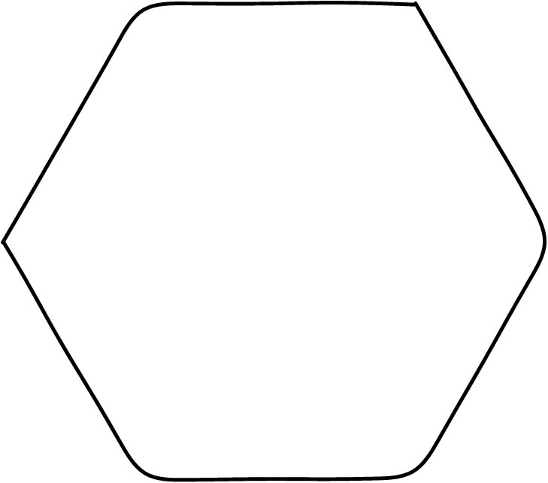

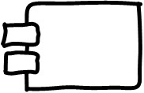
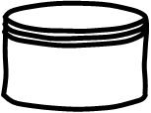
Agenda
What are Microservices? A Brief Introduction
Why use Microservices? Benefits and breaking some myths about microservices
How do we do this? Prepping for & Implementing Microservices
Here in the Real World Inspired by Real Events
Notes:
Self-explanatory

Slide 12
What are Microservices?
A Brief Introduction
Notes:
First topic: What?

Slide 13
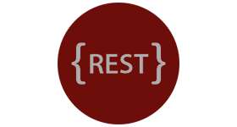
What?
Complete Stack in a Single Product
In a Nutshell
Service Front End
PURIST VIEW
Business Capability
Focused Behavior
Method to Store
State Related
To Functionality
Notes:
Here is a purist view. We have the service, business code and database in a single deployable unit. I put ReST here, as ReST is the normal paradigm for services, as it is lightweight. NOTE: ReST is still missing some tooling and you will require something for discovery and definition; the tooling is still lagging behind the technology. Worthwhile to spend a bit of time learning ReST if you are heading for Microservices. Please note you can use SOAP for your service boundary and not break the purist view. It could even be RPC (Remote Procedure Call), although I would not recommend that direction, as it more tightly couples you to a technology stack. The point is you are making the endpoint available as a boundary edge.

Slide 14

What?
Architectural Style
In short, the microservice architectural style is an approach to developing a single application as a suite of small services, each running in its own process and communicating with lightweight mechanisms, often an HTTP resource API
Architectural Style
From “Characteristics of a Microservice”- Martin Fowler http://goo.gl/AZwucZ
Notes:
If you have not read Martin Fowler’s article, it is definitely useful. The point on this slide is I am viewing Microservices as an architectural style.

Slide 15
What?
Componentization
Characteristics
From “Characteristics of a Microservice”- Martin Fowler http://goo.gl/AZwucZ
via Services
Notes:
Characteristic 1: Componentization Via Services. Business code in the component; service front end; some way of persisting state between sessions (implied in this particular characteristic). To me, this is the core of microservices.

Slide 16


Sidebar 1
What is a Component?
Definition (contract)
Implementation
Implementation
Notes:
So what is a component? It is a combination of a definition and implementation. The definition is in the form of a contract, but you may have heard this called interface (OO languages) or prototype (C languages). The concept is the same as a legal contract: If I give you {parameter(s)}, you will give me {return value(s)}. With Microservices, the definition is a service contract.

Slide 17
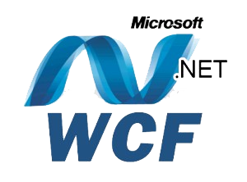

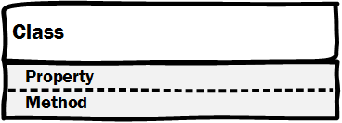
Sidebar 1
Contract
Implementation
What is a Component?
Shopping Cart
Notes:
In software, a simple component would be a single class, using an interface, with a service front end (top diagram). Juval Lowy (pictured) once suggested every single class should have a WCF service as a front end to decouple the system. Perhaps overboard, but it was very microservicey (Yes, that is not a real word). The bottom picture shows a UML component diagram with classes overlayed (this would be separate diagrams in UML, but it illustrates the concept. Notice the service front end, which makes this a microservice (or SOA, or any other service boundary concept).

Slide 18

What?
Products, not
Projects
Componentization
Characteristics
From “Characteristics of a Microservice”- Martin Fowler http://goo.gl/AZwucZ
via Services
Organized Around
Business Capabilities
Notes:
Characteristic 2: Organized around business capabilities – also a core concept for Microservices. I will reiterate this throughout the deck.
Characteristic 3: Products, not Projects. Not the best way to show this, so move to the next slide for more detail.

Slide 19



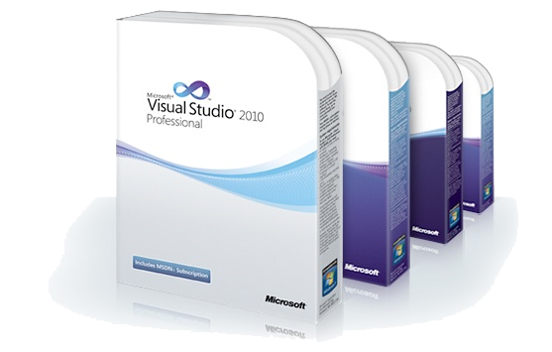
Sidebar 2
What is a Product?
Notes:
Visual Studio, shown on the left, is a shrink wrapped product. This is what we generally think of. We also tend to view any service that faces out to the Internet “cloud” (Not talking Azure or other true cloud technologies here necessarily) as a product. But we are often very willing to screw over our fellow internal programmers by changing contract. So we are not truly treating our output as a product (if we are doing that, that is).

Slide 20
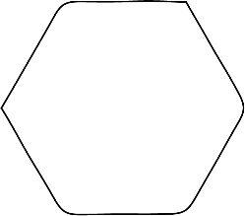



Sidebar 2
What is a Product?
Notes:
When we have lots of microservices, it becomes critical to treat out output as a product and have a single team take ownership of the product and its lifecycle.

Slide 21
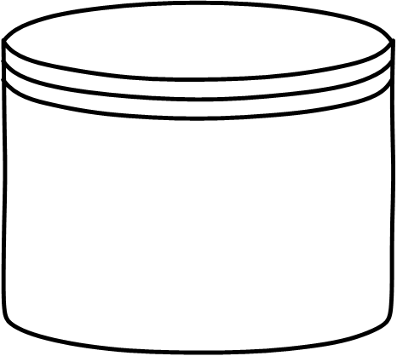



What?
Characteristics
From “Characteristics of a Microservice”- Martin Fowler http://goo.gl/AZwucZ
PHP
MySQL
C#
SQL Server
Decentralized Data
Decentralized Governance
Ruby
Mongo
Notes:
Characteristic 3: Decentralized Governance. This is the idea the team can use whatever technology is best for the product (not whatever is best for the resume, although a lot of shops seem to confuse the words product and resume ;->). Later you will see some caveats to this approach. Characteristic 4: Decentralized data. From a purist standpoint, the data moves to the service, even if you end up with duplicate data in two places. This is very much a part of DDD (Domain Driven Design), which was one of the principles applied to microservices early on. I also have some caveats to the purist approach, based on what business can actually accomplish as you build microservices.

Slide 22
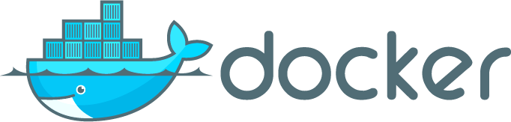


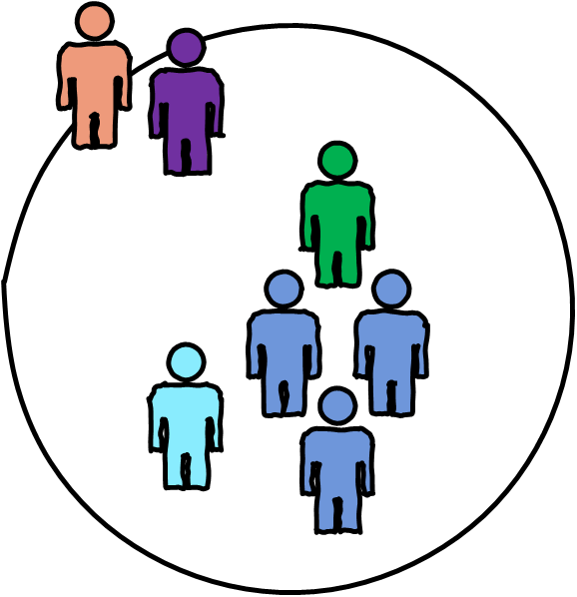









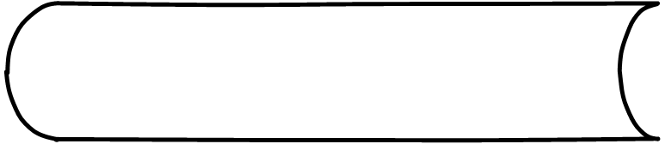






What?
Infrastructure Automation
Characteristics
From “Characteristics of a Microservice”- Martin Fowler http://goo.gl/AZwucZ
Notes:
Characteristic 3: Infrastructure Automation. To me, this is not really a characteristic of microservices as you could do a microservice architecture without it. You could also remove your own teeth with a set of pliers and a lot of booze, but I would not recommend it either. The products on this page are not prescriptive. I will find a way to detail this soon and provide details of location on Twitter (@gbworld – follow). Slide 59 shows an example I drew for a client to illustrate the concept in the real world. It is more from a legacy standpoint and not microservices oriented.

Slide 23
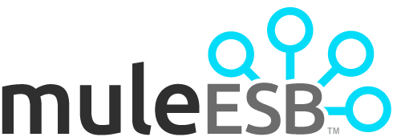





What?
Smart Endpoints
Dumb Pipes
Characteristics
From “Characteristics of a Microservice”- Martin Fowler http://goo.gl/AZwucZ
Notes:
Characteristic 5: Smart Endpoints, Dumb Pipes. I don’t feel this is a characteristic, at all, but a best practice. I would not suggest a client spend $1,000,000 on an ESB technology, but I would not push them to throw it out. Thinner is always better when you add more and more latency (which is inevitable when you break your application into hundreds (plus?) small services. Don’t add overhead in the loosely coupled glue between services. RabbitMQ is suggested often, and I find this a decent solution. I also highly recommend API Management (Apigee, Mashery (even MuleSoft’s API platform)) and will often have clients more focused on that (it is commoditized, as you purchase it; while you have to do a bit of coding to implement ESBs and queues – Yes Rabbit MQ, the product, is commoditized too, but far more development time).
NOTE: After the Code Mash talk, one participant said “I am going to tell my boss you think we should never use an ESB”. I hope I did not seem to convey that idea with the red X coming up so fast (one missed transition). Here is my real advice of when you can use an ESB: 1. You have already purchased one 2. You are using a distributed ESB, like Tibco, and mostly focused on it for message delivery between services – See Kai Waehner’s blog entries (here is a really good one to start with - http://www.tibco.com/blog/2015/01/30/a-complete-guide-to-tibco-for-microservices-and-devops-part-1/)
3. You are utilizing an ESB in an API centric way, like Mulesoft pushes

Slide 24




What?
Evolutionary Design
Characteristics
From “Characteristics of a Microservice”- Martin Fowler http://goo.gl/AZwucZ
Notes:
The last characteristic is evolutionary design, which means our services should be able to adapt to business change. This is not really a characteristic of microservices, but a characteristic of good development practices.

Slide 25
What?
Microservices
Agile Practices
Componentization via Services
Organized around business capabilities
Products not Projects
Decentralization (governance, data)
Evolutionary Design
Characteristics
From “Characteristics of a Microservice”- Martin Fowler http://goo.gl/AZwucZ
DevOps
Infrastructure Automation Smart Endpoints, Dumb Pipes
Notes:
Here is my organization. If you have the first two, you could conceivably develop microservices. When I do a readiness analysis for clients, I will make sure they have the following, or at least plans for the following: 1. Automation of the Delivery Pipeline (this will likely be a talk soon) – This is the Infrastructure Automation piece. I recommend containers (a bit prescriptive, as Docker is the winner here, although I push Docker/Kubernetes as a pair). But, you can conceivable automated real hardware deployments (not recommended) or virtuals (almost identical concept as Docker, but with hypervisor as the overhead). 2. Monitoring – If you are spread across multiple services (possibly hundreds or more), you need something to proactively pinpoint to problems. Or, better yet, to potential problems. I find APM solutions (Application Performance Monitoring) to be most useful, as they can drill down to the exact line of code when a problem occurs and, even more important, follow a transaction path through the system. I work a lot with CA, as they acquired Nimsoft for UIM (Unified Infrastructure Monitoring) to accentuate their APM solution. But, I have worked with AppDynamics, as well (and possibly Dynatrace in the next month or so). Not really as worried about the product as much as the monitoring abilities (if I am recommending, it will be on client requirements versus price – find the least expensive that fits the 80/20 requirements of their business).
3. At least enough Agility (or adoption of the Agile product mindset) to accept all work as a product, not just a project. Ownership is one of the main keys here.

Slide 26
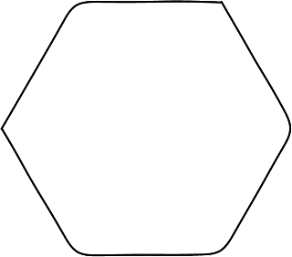



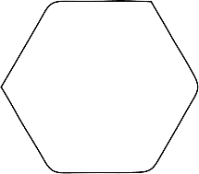




What?
How Big is a Microservice?
It’s not about lines of code!
Notes:
For this, just remember it is not about the size of the service.

Slide 27
If it is not about lines of code, what is it about?
Business Capabilities
Notes:
Back to business capabilities.

Slide 28
Why Use Microservices?
Benefits and breaking some myths about microservices
Notes:
Why?

Slide 29
Why?
Better than Monoliths
Easy to
Understand
Enhance
Test
Deploy
Resilience
Low impact on other services
Autonomy of Teams
Decentralized Governance
The Benefits of Microservices
Notes:
Summary up front and then I get cantankerous.

Slide 30
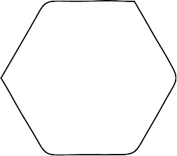



Why?
Loose Coupling
Independent Scale
Flexibility
Tight Cohesion
SOA
Monolith versus Microservices
UI
Service
Business
Data
Microservice
Architecture
Layered Architecture
Monolithic Architecture
Notes:
This is our view of Monolith versus Microservice with a more real set of architectures in the middle. Not that none of the audience uses true monoliths, but that is normally “true” legacy (mainframe?). As you can see the benefits of deconstructing a monolith is independent scalability of pieces, flexibility in deployment, loose coupling and tight cohesion. And who doesn’t like all that chewy, caramel goodness.

Slide 31
In a Properly Architected Solution, What is the difference between a monolith and a microservice
Boundaries and deployment methodologies
Notes:
Already covered this. Slide 49 and 50 not that far away so you can drill in.

Slide 32
Why?
Easy to Understand
Easy to Enhance
Easy to Test
Easy to Deploy
Microservices are Easy
Notes:
Assumptions about ease. Let’s tear this one to shreads.

Slide 33


Why?
Item | Microservice | Monolith
Lines of Code
Easier to understand
Easier to enhance
Easier to test
Easier to deploy
500
1,000,000
Microservices are Easy
A+
Notes:
Obviously, small is easier to understand, enhance, test and deploy. A+ on the “well duh” test, right?

Slide 34

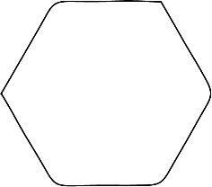





Why?
This is easy
Microservices are Easy
This is not easy
Notes:
But a single service (hard to see on the slide unless you play with it), things are easy. In the microservices architecture, it is just another version of “not easy” (aka hard, difficult, complicated).

Slide 35
Sidebar
Inner
Outer
Complexity
Complexity
SOA
Complexity
UI
Service
Business
Data
Microservice
Architecture
Layered Architecture
Monolithic Architecture
Notes:
So we are not really losing complexity, we are pushing it out.

Slide 36

Why?
Energy cannot be created or destroyed, it can only be changed from one from to another.
Microservices are Easy
– Albert Einstein
Notes:
Here is the Albert Einstein quote I am plagiarizing, er borrowing.

Slide 37

Why?
Complexity cannot be destroyed, it can only be changed from one from to another.
Microservices are Easy
– Gregory A. Beamer
Notes:
But I take out the word create, as I have seen lots of ignorant (and/or stupid?) people create a lot of complexity. NOTE: Ignorant is not an insult, it is just a description of someone who does “not know” something. Stupidity is refusing to learn. See the difference? BTW, do you like my Einstein pose?

Slide 38
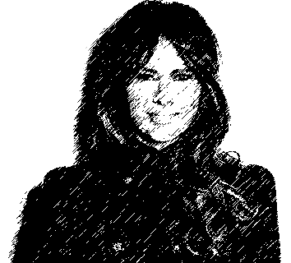
Why?
Microservices are Easy
Feeling like Melania Trump at a plagiarism conference
“I did not copy off Michelle’s Paper!”
– Melania Trump
Notes:
Yeah, another cheap joke, but when I go to the slide without introing it, it sure works. Did not have time to stick Michelle Obama in the background. Pity. It would have amped up the laughs a bit?

Slide 39





Why would you prefer outer complexity over inner complexity?
Because you can commoditize it!!!
Notes:
If we change form of complexity, from inner to outer, we can commoditize the complexity. Here I am focused on API Management, but you will likely have some commoditize “glue” between services, like a message queue, or even an ESB.

Slide 40

Why?
Microservices are Easy to Deploy
Notes:
This slide is also not as great without the animations. Here is the two points 1. It is hard to deploy if you run deployments from a document – i.e., you do not automate
2. It is hard if you don’t automate (wow, sounds redundant when you put it in type)

Slide 41
Why spend all that time automating?
Because your ops people have better things to do
Because you can commoditize it!!!
Notes:
Seriously, your ops people do have real problems other than the ones you create for them. Of course, you may also have ops Nazis, in which case you need to go back to Slide 10 and map out a way to get to the Plateau of Resume Bullet Points.

Slide 42
Why?
Resilience
Low Impact on Other Services
Notes:
One stated benefit is low impact on other services. Yes, this can be true, but only if you build it in. The slide shows what happens if you don’t have an abstraction. As the lowest service fails, it cascades up. API Management and Queues can help with this, as they both abstract out the connectivity between services. API Management does this by proxying the endpoint. Queueing essentially does the same thing, but you do not call it proxying. You should also examine circuit breakers and bulkheads (Slide 55).

Slide 43



How do you insure low impact on other services?
Because you can commoditize
… and WORLD PEACE!
Notes:
I use the word Commoditize a lot, right? World Peace just seemed like the right word to add to get the audience to respond (saw it in a movie?). And who wouldn’t want to see beauty pagent contestant in a formal dress with a set of handcuffs? Okay, maybe I took that one a bit over the line?

Slide 44
Why?
Resilience
Orchestration
Choreography
Notes:
I start with orchestration on this slide. Orchestration is the concept of combining things up the stack. In an extreme form, think of a conductor leading an orchestra. All eyes are pretty much on him, although different first chairs can help “aggregate” their sections. Think pyramid for an analogy of how the “blocks” fit. Choreography is more like a dance piece in a musical. The dancers can watch any of the other dancers to keep their steps in line. Just like the services here, it is best to watch the same dancer every time you perform. Not shown on the slide, unless you run it, is the idea that you can actually create circular references from service to service (it is logical, not physical, so the compiler won’t catch it). NOTE TO SELF: Need to create a circular reference example to illustrate it will compile.

Slide 45
Which is a better pattern: orchestration or choreography?
Which is better: A hammer or a screwdriver?
Hammers SUCK!!!
Notes:
The point here is neither is automatically superior. I would generally go for choreography with abstraction between the services (API Management and/or queueing). But orchestration helps if you have external apps and a lot of microservices. Better to return a single object to a mobile client than chat up a storm, at least in most cases. This would mean “use choreography internally, but aggregate using orchestration” One note from a question after the session: While you will use orchestration to reduce chattiness, if some data does not come through immediately, you should send what you have in most cases and then provide links to the underlying service for the app to get the missing data. ReST hypermedia is a great way to do this.

Slide 46
Why?
C#
Python
SQL Server
Autonomy of Teams
PHP
F#
Mongo DB
Oracle
Java
Couch
Notes:
Autonomy of teams means every team can use a different technology. Yeah!!! Right?

Slide 47
What do you call an organization with hundreds of microservices & every new technology known to man?
Bankrupt!
Notes:
But too many doing this could lead to having to job security for way too many people. That is expensive and leads a business out of business. Either by paying too much for employees, or letting the wrong ones go.

Slide 48
How Do I Do This?
Implementing Microservices
Notes:
How?

Slide 49
How?
CASA Development Model
Core AS Application
Test Driven/
Test Early Approach
TDD
BDD
Organize Your Code
ATDD
Adapter-based
Boundaries
TESTS
ADAPTER
ADAPTER
CORE
CONTRACT
CONTRACT
ADAPTER
ADAPTER
Contract First Development
DOMAIN
Domain Driven Design
Notes:
This is my development model. I created it as Core AS Application in 2010. I created CASA as a name in 2016 due to not having a cute name. It has nothing to do with a Mexican house, although I could make up some really good BS to explain why it is CASA. But, then, Scrum, as a word, does not really apply to Agile, except perhaps when Scrum teams get in a tight circle and punch each other in the face. As a rule, I tend to avoid these shops.
The idea is the Core is the Application and you should be able to change out persistent mechanisms (where you store state between sessions) and experience layers (UI, for example, but a service is a means of interaction – not human, but machine).
Core is where the business logic goes.
Domain models go at the bottom of the core. NOTE: you can create models on the experience “layer” as well; this is what MVC (and MVVM, etc) do. This works with Domain Driven Design (ddd), although I separate behavior (in the core) from state objects (domain models). The models the gird up Core should be behavior-less, at least as the rule, and business focused. The sides are contracts to abstract out the core from persistence and experience. Think interfaces in most languages. These contracts allow you to change implementation at any time. Designing the contracts up front is the safest manner (Contract First Development). NOTE: I adhere to consumer driven contracts, which means the people using my microservices will tell me what I need. I do not design microservices on top of data, as that creates CRUDdy services. Adapters help you connecting to different persistent and experience projects.
At the top are tests. I have a few buzzwords to make this slide look really cool, but covering your code properly is more critical than writing all of your tests prior to coding. I am an advocate of XDD (TDD, BDD, etc.) types of styles, as they help you design up front, but much of this can be facilitated with contract first approaches even if you do not use XDD (NOTE: Since TDD can be acceptance driven, ATDD is a BS word).

Slide 50
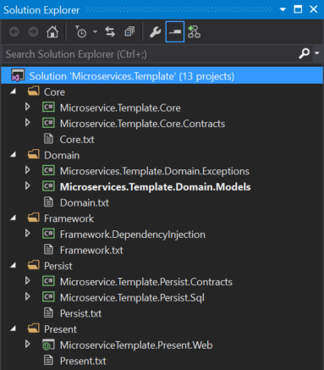
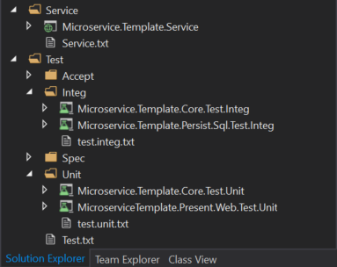
Notes:
This slide shows that I can really do this in the real world. Here is my method of filling this in. This is essentially Onion Architecture, although I do not keep the domain behavior (Core project) completely inverted. I will share the project once I get a chance. Subscribe to @gbworld on Twitter for upcoming details.
Start with the green arrow and design the dumb domain models (dumb meaning they hold state, but have no behavior) – Every other project will use this one
Bonus – start developing exceptions used in the application and store here NOTE: Sometimes exceptions can become more global and end up as a reference
Don’t test getters and setters (at least not in most cases). If Microsoft (or Oracle) forget how to get and set, you will have a much bigger problem testing will not solve. It is a waste of time to test state only objects. If you do add code to aggregate or calculate (private set; public get?), then you might want to test.
Fill in the contract projects at every level.
You can now do in any order, but I will generally start on my repository to fill the domain models and then go to core to build up behavior. I will use a Test driven approach to test these.
I then move to Services and/or Present (for Presentation – need to update slide), depending on application type. I used to keep services in the Presentation folder, but found that confused people who could only envision things users dinked with (UI) as Presentation. In reality, you are presenting in services, although it is just data and it is designed for computers to understand, not people.
My test folder is organized in this way:
Accept are acceptance tests that are pure acceptance. Things like Fitnesse tests go here
Integ are Integration tests. They look exactly like Unit tests, but use the actual objects instead of mocks, fakes or stubs. If state changes, I will set up some data and/or revert changes after the test runs. This is so I don’t influence other tests. One test (or test class?) should never influence another test; they should be able to be independently run. If you have a string of tests that have to run in a particular order, you should set up the data changes from the first test in the second test rather than count on tests running in a particular order (NOTE: Some test frameworks allow this insanity, but better not to rely on it)
Spec is for Specification – This is SpecFlow for me, but could be other Behavior tests using a jspecification language to describe them (like SpecFlow)
Unit should be obvious. Use the contracts to mock out dependencies (or stub or fake).

Slide 51
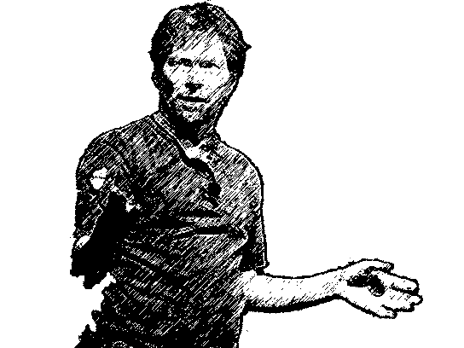
How?
Hexagonal
Architecture
Organize Your Code
Clean
Architecture
Notes:
Here is my Core blue circle over Alistair Cockburn’s Hexagonal Architecture. Someone now calls this “Clean” Architecture, which means I want to slap him. I hate using superior sounding words for anything, as we will likely find an even better architecture in the future. Here is the progression:
Clean Architecture
Cleaner Architecture
Cleanest Architecture
We need another damned word meaning cleaner than cleanest architecture
My advice: Don’t do drugs. Hexagonal describes this better, let’s not use our bias to pontificate. Of my pony pedestal of pontification now.

Slide 52
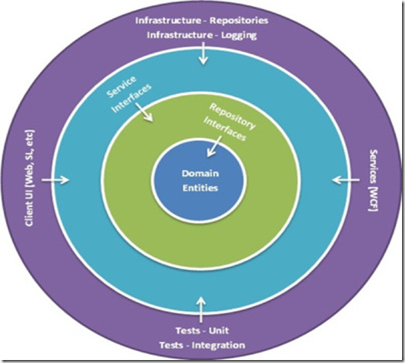
How?
Organize Your Code
Notes:
This is the same architecture looking like a Willy Wonka Everlasting Gobstopper. It is called Onion Architecture, cause architecture’s got layers. But parfaits have layers too, although Ogre’s aren’t like Parfaits. I hope you get the reference. If not, there is the obscure tool called Google.

Slide 53
How?
CASA Development Model
Core AS Application
Test Driven/
Test Early Approach
TDD
BDD
Organize Your Code
ATDD
Adapter-based
Boundaries
TESTS
ADAPTER
ADAPTER
CORE
CONTRACT
CONTRACT
ADAPTER
ADAPTER
Contract First Development
DOMAIN
Domain Driven Design
Notes:
A double dip of my architecture, which is pretty much the same thing showing how you map some best practices into the whole thing. Nice, huh? NOTE: I developed this before some of the other models. Not stating anyone stole it, but rather than we independently realized the same idea, making an implied consensus amongst some architects. ALSO NOTE: There was once a consensus the world was flat, so don’t see this as a silver bullet. It works wonderfully now, but paradigms change over time.

Slide 54
How?
SOLID Design Principles
You know these right?
Domain Driven Design
State Objects
Core Business Logic
Other Concerns
Contract First Development
Customer Driven Contracts
Best Practices & Patterns
Notes:
This was a last minute addition to the deck as I felt it was both a) important and b) a good follow up to CASA. ¿Comprendes?
SOLID is obvious, although I am mostly focused on D. If you have not used SOLID, please look it up. Very useful stuff. Domain Driven Design – I am not a purist of Eric Evans ideas and I was already using the separate of behavior and state before I found his book. Evans does a great job of explaining how to model a domain, so it is something you should have on your shelf. There are some books that better distill the ideas, including Domain Driven Design Distilled and Evans has created Domain-Driven Design Reference as a distillation. If you are in .NET, the book Applying Domain Driven Design Patterns is very useful, as there are C# examples.

Slide 55
How?
Circuit Breakers
Bulkheads
Best Practices & Patterns
Bulkheads
Circuit Breakers
Notes:
Here is the slide that was missing the pictures. Nice they are there now?
Circuit Breaker – like the one in your house. Fails after X (1 or more) failures getting to a service and waits for a reset. If you use abstraction, you can reduce the times it actually flips, as the abstraction will help handle the retry for you. Add in monitoring to aid the abstraction (I mentioned I want to use monitoring with API management and Docker/Kubernetes to automate the entire retry mechanism – Did you say I should use that obscure Google tool to see if someone has already done this? Hey! Good idea!!!). Bulkheads are like bulkheads on ships. The Titanic sank because too many bulkheads were breached. You can see both in the diagram above.

Slide 56
How?
What is a Capability?
Organize Around Capabilities
Any business function that can be coded as a stand alone
Any business function that can easily be handed off to another team
Any business function that can be handled by another company
Notes:
Business capabilities are specific business functions that can easily be segregated from other business functions. If you accidentally pick an aggregation of capabilities, you can always deconstruct further a

Slide 57


How?
Which of these are capabilities?
Organize Around Capabilities
Shopping Cart?
Purchase Path?
Company Catalog?
User Access?
Database Access?
Notes:
It should be clear all of the green are capabilities. With Amazon (example logo here), all of the functions are in one platform. But there are other products that focus on a single one of the capabilities, so they can be segregated completely. For User Access, there are also things like oAuth (allow Facebook to help with authentication? What?) Database access is red, which means stop (sans the octagonal sign). Do not create CRUD based microservices.

Slide 58
How?
DevOps
Automate the Delivery Pipeline
Notes:
Back to automation. This is the one part of DevOps I drill on over and over again. If you don’t automate, it will come back to haunt you when you are chasing hundreds of tribbles, er microservices, all over your starship, er application platform.

Slide 59
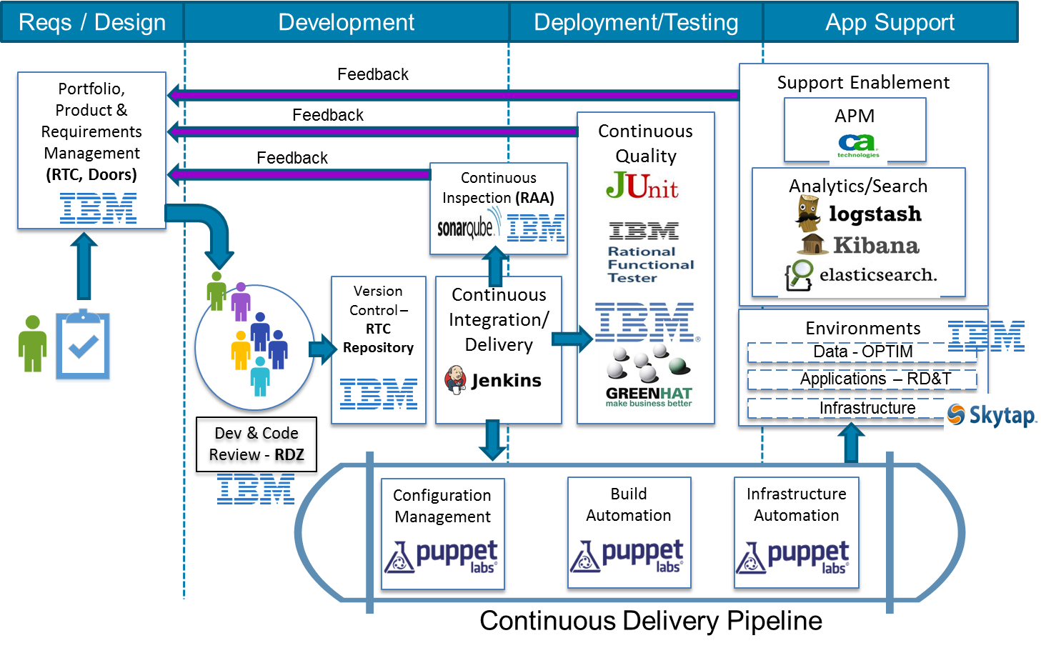
Notes:
Here is a diagram I created for an unnamed client. The tools are specific for our recommendations here, some due to their adoptions prior to the client call. This is a stack for mainframe, but could be for microservices in legacy automation (Slide 68 – which a lot of people took pix of, so must be a big thing for many peeps).
Don’t get caught up on the particular products, as there are others. We use Bamboo for some deployment functions, as well. And Chef can fairly easily replace Puppet.

Slide 60


How?
Monitor Your Solution
Notes:
Monitoring is also critical. I have CA here, as CA is someone we work with quite a bit. They have both unified infrastructure monitoring (UIM), from acquisition of Nimsoft, and APM. But I could have use AppDynamics for the APM piece, with a partner product for network and infrastructure monitoring.
I have monitoring feeding the ticketing and requirements system (in this case Jira), so any issues (or potential issues) can be fed in so they can be prioritized as part of the work load. As part of the automation pipeline, failed tests should also feed in.

Slide 61
How?
How do we abstract?
API Management
Message Queueing
Abstracting Service Boundaries
Stay in the room for Shawn’s talk (NEXT) to learn more about abstraction with an event-driven approach
Notes:
Here we are talking about Abstracting Boundaries (perhaps I should have changed that before the session?).

Slide 62

How?
Abstract
No ESB, right?
Notes:
And we circle around and find we can actually have small services as system APIs to add another level of abstraction, but the real “microservices” are what Mulesoft calls Process APIs. Experience APIs are added if formats need to change to get the models for a particular implementation. Remember UI models are not necessarily our domain models.

Slide 63
Here in the Real World
Inspired by Real Events

Slide 64
Real World
Let’s Make Asssumptions
We are a board game company
We recently completed a kickstarter
The game is selling
We need to go beyond the kickstarter and sell on our own
Determining Services: Decomposition
Notes:
Some assumptions for a real world example. Can you say e-Comm?

Slide 65
Real World
Shopping Cart
Determining Services: Decomposition
Item Lookup
Shopping
Cart
Wish Lists
Security
User
Payment
Notes:
One business capability is a Shopping Cart. As we think of it, this will include some features around user management and security. You will also have payment, item lookup and wish list.
It is a good idea to break into business capabilities, it is easier to start a larger and decompose into smaller services than the other direction. Your larger service can continue to serve as an orchestration of the smaller services until all clients are off. And, as mentioned previously (notes in slide 45), orchestration can be used to aggregate to reduce service calls.

Slide 66
Real World
What if we are green field?
Same Process
Gather Requirements (stories?)
Find business capabilities
Determining Services: Decomposition
Notes:
On the last slide, we assumed a brown field deconstruction, but it is similar with green field. The main benefit is you can deconstruct during planning, rather than after you have built anything, and avoid orchestration on a service.

Slide 67
Real World
What if I have larger services?
Orchestrate and Deprecate
Determining Services: Decomposition
Notes:
Reiterating. You can start larger and then break down into smaller services orchestrated by the original service. You can then deprecate the larger service later.

Slide 68
Real World
01
Legacy Refactor
Risk averse modernization
02
Legacy Façade
Add functionality to workflow
Legacy
Modernization
UI
Legacy screens
or web pages
Process (business)
service
BRM
BRM
Data
service
Notes:
Here is an example for legacy modernization, which assumes you are starting with a monolith on a mainframe system (AS/400?). The legacy side is blue and the modern side is green. 1. Legacy refactor – The starting point is a mainframe program (COBOL or RPG most likely) that consist of a full stack in a single file – in general, one file per screen. In AS/400, this would most likely be a CICS program. If the program is not CICS, you may need to update it to CICS prior to other modernization steps.
Notice you have a UI layer, Process layer and Data layer (remember the Mulesoft slide – Slide 62 or see Slide 69). The slide does not show the original file, which is full stack, but what happens after you separate the UI file and underlying data files (there is an assumption that most of the smaller files will be CRUDdy, as that is quite popular in mainframe programming). You then start migrating towards Microservices (the modernized side). You build up the microservice side by developing service contracts, then implementing by linking the service to the CRUD files at the lowest level. You also build the UI on the modernized side. The next step is to point the UI CICS to the same microservices as the new web UI on the modernized side. You have now abstracted the underlying CRUD services on the legacy side and can slowly build up services on the modernized side.
2. Legacy Façade – On this side, you build functionality in the modernized platform. You can then build a legacy UI screen, if required.

Slide 69
Real World
Don’t do this!!!
Data Focused Microservices
Notes:
Don’t start building services on top of a database. This is cruddy.

Slide 70
Real World
Data Focused Microservices
Notes:
But it is not as bad of an idea to use services to abstract out data. I would not do this if your service is very small, as you can rewrite the entire service in a single Agile iteration (A single Scrum Sprint for example).

Slide 71
Real World
Scaling
Notes:
Scaling your service? Let’s assume we are using docker containers (purple boxes). If you want to scale a service, you need to add more purple boxes (more containers).

Slide 72
Real World
Scaling
Notes:
This is a more realistic picture. The database is in a linked container that can be deployed separately from the service container. Sounds a bit like an n-tier system?

Slide 73
Real World
Central Database
Notes:
What if you can’t divide the data out into multiple databases? Not ideal for microservices, but you can point at the operational data store (ODS).

Slide 74
Real World
Best Practices
A single microservice owner for each table – if possible
All access through the microservice
Central Database
Notes:
Ideally, individual data items should only have one service controlling them, so you are logically following the microservice ideal. Also consider updating the architecture over time to move towards a more purist system, as it increases control.

Slide 75
Real World
In a purist environment, you will have to consolidate the data at some point
Be prepared to introduce Master Data concepts
How do you eat an elephant?
One bite at a time
Other Notes
Notes:
Please note there is no free lunch. To report and run analytics, you must aggregate the data on the fly or integrate the data in a system, like a data warehouse, prior to running the report. The later is my preference.
Please note that the more service interactions you have, the more likely you will duplicate some data. If you do this, consider introducing master data concepts in your environment so you get a single source of record for each type of data (perhaps this should be a future talk?)

Slide 76
Microservices
Code Mash Edition
Lessons from the Trenches
@gbworld
Notes:
Subscribe to my Twitter account (@gbworld) to keep up with future developments, including YouTube videos, video courses (Udemy or Pluralsight?) and blog entries.

